Slide 1

IT Professional Fundamentals: Networking
Why Networking Is Important
Vlad Catrinescu
Office Apps and Services MVP
@vladcatrinescu https://VladTalksTech.com
Notes:
Hello and welcome to this IT Professional Fundamentals: Networking course ! My name is Vlad Catrinescu, and I will be your instructor for this course. I am a Office Apps and Services Microsoft MVP from Montreal Canada, and you can find me on twitter at vladcatrinescu or follow my blog at VladTalksTech.com . In this first module, we will take a high level look at what Networking is and why it’s important to our every day lives.

Slide 2
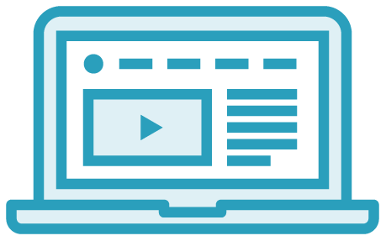




We Are Always Connected
Notes:
Today we are always connected to the Internet, whether it’s on a more traditional device such as a laptop, a tablet or a desktop computer, all the way to our cars, and household items such as smoke sensors, door locks, light bulbs and thermostats are now monitored and controlled from anywhere in the world via the internet. Today we already have more devices connected to the internet than human beings on the planet. All of this is possible because of networking, and while when we get a new smartphone it just works, or we connect a laptop to a WiFi and everything works, there are quite a few configurations and hardware on the backend that make it all possible.

Slide 3






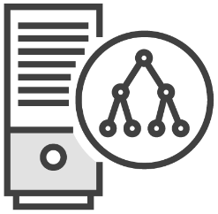



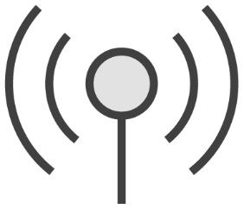


Notes:
Your common network will have multiple hardware devices such as Routers, Switches , Wireless access points and different servers such as a DNS and a DHCP Server that will make it possible for you to connect to the network, get an IP Address which is the logical address of your device on that network , and navigate from your local network to the internet.

Slide 4
Internet Protocol
Internet Protocol (IP) is the principal set of digital message formats and rules for exchanging messages between computers across a single network or a series of interconnected networks.
https://www.techopedia.com/definition/5366/internet-protocol-ip
Notes:
When we talk about anything network, we use the word IP a lot in words such as TCP IP , IPV4 and IPV6 and so on, and IP Stands for the Internet Protocol. IP is a protocol. Simply said, a protocol is a set of rules governing how things work in a certain technology so that there is some kind of standardization. When put into a network communication context, an internet protocol describes how data packets move through a network. When you have a protocol, you are sure that all machines on a network (or in the world, when it comes to the internet), however different they might be, speak the same "language" and can integrate into the whole framework. The IP protocol standardizes the way machines over the internet or any IP network forwards or routes their packets based on their IP addresses. This is the foundation of rules which makes sure all of our devices in the world can talk to each other.

Slide 5
Course Agenda
Network Configuration Concepts
Networking Hardware
Network and Internet Connection Types
Protocols for Wireless Networking
Networked Hosts and Their Services
Network Troubleshooting Tools
Notes:
In this course , we will really understand what makes all the connectivity that we talked about before possible, and looking at what are all of the different components of a network. We will first talk about Common Network Configuration Concepts such as what is IP addressing, what’s DHCP and DNS, TCP ports and more! We will then learn about the hardware you will find on a network such as network interface cards, Hubs, routers, switches, and more. We will then learn about the different Network types, and Internet connection types. Next up, we will learn about the different Wireless Networking Protocols. Wireless is not only wifi, but also Bluetooth, nfc, rfid and we will learn the differences and benefits of all. We will then learned about Networked Hosts and the services they provide , and finally learn about some network troubleshooting tools. At the end, we will have a module where we will take everything that we have learned and see how we would configure a Basic Home and Small Business network.

Slide 6


Course Details
General networking knowledge
Basic computer skills
Notes:
This course is aimed at anybody who wants to learn about the basics of networking, whether you are just preparing your IT Career or you want a refresher on those concepts. Some of you might be studying this for general networking knowledge, but this course is also useful if you want to get certified in Computer Fundamentals with an exam such as the CompTIA A+ exam. Lastly, there are no real prerequisites for this course as it’s a computer fundamentals course, however of course basic computer skills are recommended. If you managed to connect your PC to a network and come listen to this course on Pluralsight, you should already be good to go!

Slide 7
Up Next:
Common Network Configuration Concepts
Notes:
So let’s get started learning Networking , with our next module, Common Network Configuration Concepts

